Slide 1
Feature-Based Detection
An “Expert System”: Attempts to create artificial intelligence by mimicking the knowledge of a human expert:
Identify key aspects of the problem (“body of knowledge”)
Know how to weight those aspects to reach a decision (“inference”)

Slide 2
Digit Identification: Features (1)
What features can we identify that distinguish different digits?
Closed loops, and their location:
One, at the top: 9 (or 4?);
One at the bottom: 6 (or 2?);
two vertically: 8
Open loops (“cups” or “umbrellas”)
Open at the top: upper: 4; lower: 5 (and 3? 6?)
Open at the bottom: 2, 3 (and 5, 7? 1?)
3) Sideways curves, top or bottom: 2 and 3; 3 and 5

Slide 3
Digit Identification: Features (2)
What features can we identify that distinguish different digits?
Location,” thickness”, and length of lines
1 is thin all the way down
7 is “thick” at the top, and thin in middle and bottom
4 is “thick” in the middle
Number and distribution of “horizontal” lines:
2, 3 and 5 (and 9?) have 2-3 for left and middle
6 has 2 - 3 middle - right
Width of characters? Good(ish) for 1, but not much else.

Slide 4
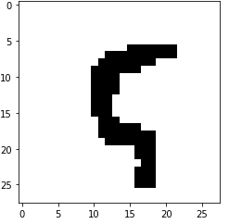
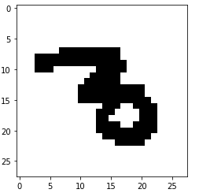
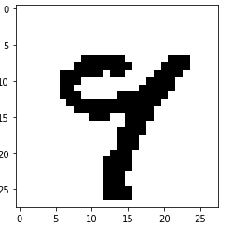
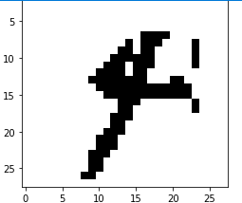
Problems
Handwritten numbers are incredibly variable, and often “poorly” drawn:
Loops don’t close (or do!)
Digits often written “slanted”
Curves often reduced to lines, or vice versa

